Slide 1
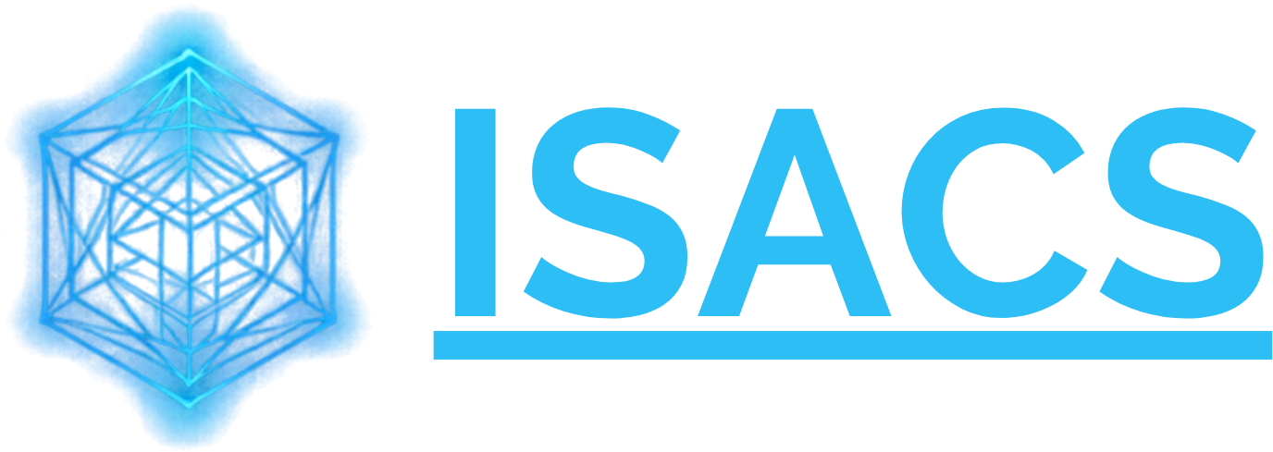




Secure. Smart. Creative.
Cybersecurity
Cloud & Managed IT
Artificial Intelligence
Securing your infrastructure. Animating your imagination.
Graphics, 3D & Animation

Slide 2

Two worlds. One partner.
Intelligent Systems, Animation & Cloud Services
ISACS protects the technology your organisation runs on, and brings your ideas to life with world-class visuals.
Technology
Creative
Secure what you run
Animate what you imagine

Slide 3

Five services, one roof
Managed IT Services
Reliable support and monitoring for your business systems
Cybersecurity
24/7 threat monitoring and protection for your network
Cloud Services
Scalable, secure cloud hosting and migration
Artificial Intelligence
Intelligent systems that automate and inform decisions
Everything under one roof
Graphics, 3D & Animation
Product renders, motion graphics and immersive visuals

Slide 4
Securing your infrastructure
Cybersecurity
Round-the-clock defence against evolving threats
24/7
Cloud Services
Secure hosting and migration that scales with you
threat monitoring and protection for your network
Managed IT
Proactive support so your systems stay online

Slide 5
Animating your imagination
Artificial Intelligence
Graphics, 3D & Animation
Intelligent systems that automate work and inform decisions.
Product renders, motion graphics and immersive visuals.

Slide 6
Why choose ISACS
5
24/7
1
core services under one roof
threat monitoring and protection
partner for technology and creativity

Slide 7

Ready to join us?
Let ISACS secure your systems and bring your ideas to life.
Get a Free Consultation
Secure. Smart. Creative.
isacs.ls

